Slide 1
DM TA Session 3
Hanwen Serena Xu
hanwen@uchicago.edu

Slide 2
Contents
HW2
PCA
T-SNE
Questions

Slide 3
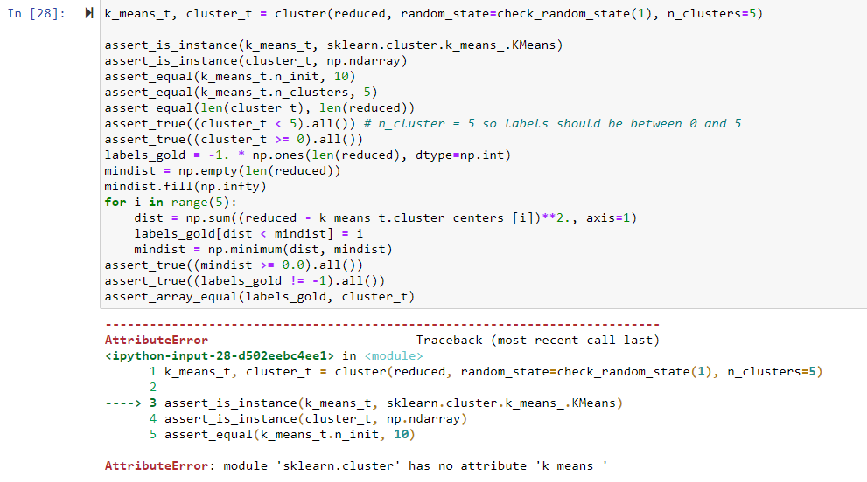
HW2 unit test Problem 2
assert_is_instance(k_means_t, sklearn.cluster._kmeans.KMeans)

Slide 4
PCA
A commonly used data reduction technique
Seeks to find linear combinations of the predictors, known as principal components, which capture the most possible variance
The first PC captures the most possible variance
Primary advantage - PCA creates components that are uncorrelated

Slide 5
Transform data before PCA
PCA seeks linear combinations of predictors that maximize variability, it will naturally first be drawn to summarizing predictors that have more variation
PC weights will be larger for the higher variability predictors on the first few components
Data usually have predictors are on different scales and predictors may have skewed distributions

Slide 6
Transform data before PCA
It is recommended to transform data before applying PCA
Enables PCA to find the underlying relationships in the data without being influenced by the original measurement scales
StandardScale vs Normalizer

Slide 7
How to choose # of PCs?
Scree plot criterion
Proportion of variance explained criterion

Slide 8

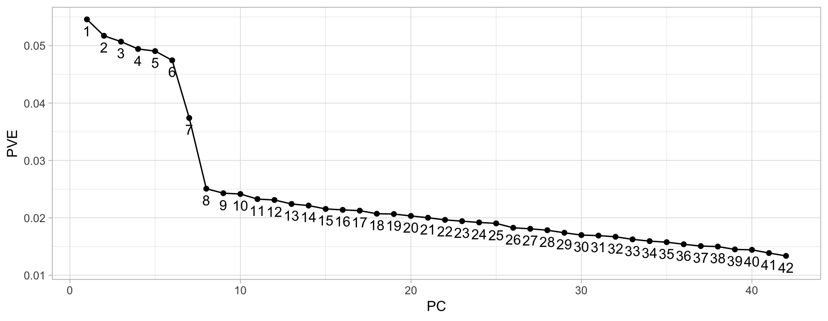
Scree plot criterion
A scree plot shows the PVE for each individual PC
Most scree plots look broadly similar in shape, starting high on the left, falling rather quickly, and then flattening out at some point
This is because the first component usually explains much of the variability

Slide 9
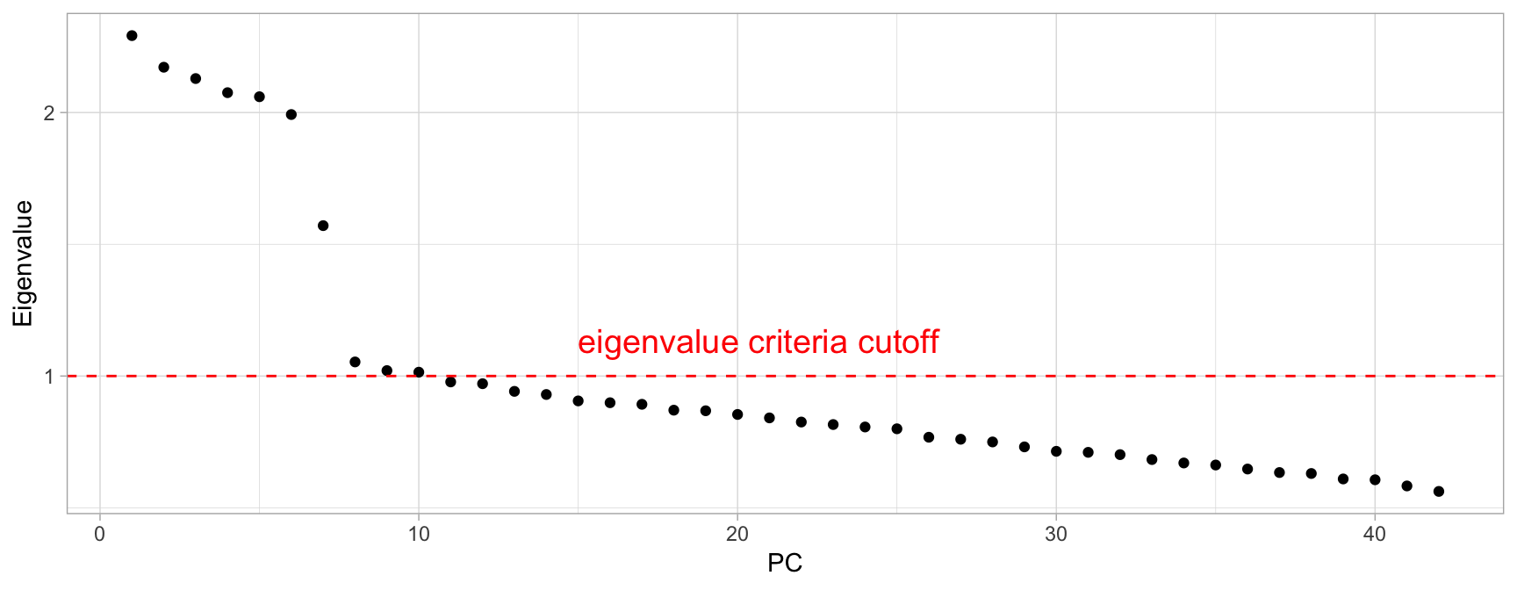
Scree plot criterion
To deal with a not-so-ideal scree plot curve, there are a couple ways:
Kaiser rule: pick PCs with eigenvalues of at least 1.
Proportion of variance plot: the selected PCs should be able to describe at least 80% of the variance.

Slide 10
Proportion of variance explained criterion
The proportion of variance explained identifies the optimal number of PCs to keep based on the total variability that we would like to account for
What amount of variability is reasonable?
This varies by application and the data being used
Standard rule to cut off # PCs is 85%
When the PCs are being used for descriptive purposes only then the proportion of variability explained may be lower than otherwise
When the PCs are to be used as derived features for models downstream, then the PVE should be as much as can conveniently be achieved, given any constraints

Slide 11
Cons of PCA
PCA can be highly affected by outliers
PC directions are linear and traditional PCA does not perform as well in very high dimensional space where complex nonlinear patterns often exist

Slide 12
Questions about PCA?

Slide 13
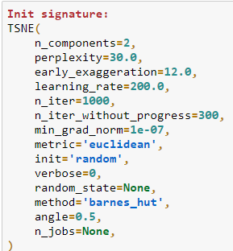
T-SNE
t-SNE is non-convex, meaning it has multiple local minima and is therefore much more difficult to optimize. The authors use various tricks to alleviate this, but there are no failsafe methods to reach the global minima. This fact has an important consequence: t-SNE is non-deterministic. You can run it multiple times and get a different result each time.

Slide 14
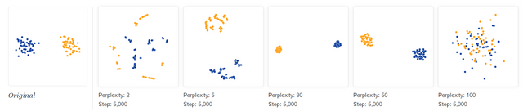
T-SNE Epsilon And Perplexity
Epsilon - learning rate
Perplexity tells how to balance attention between local and global aspects of your data. The parameter is, in a sense, a guess about the number of close neighbors each point has
Changing perplexity has a complex effect on plots
“The performance of SNE is fairly robust to changes in the perplexity, and typical values are between 5 and 50”

Slide 15
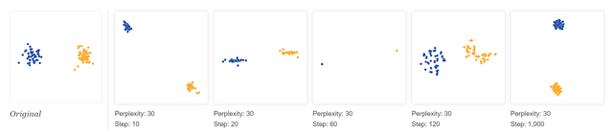
T-SNE Epsilon And Perplexity
If you see a t-SNE plot with strange “pinched” shapes, chances are the process was stopped too early
Unfortunately, there’s no fixed number of steps that yields a stable result
Different data sets can require different numbers of iterations to converge

Slide 16
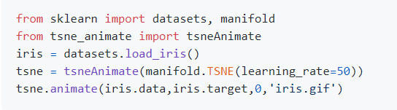
T-SNE
Cluster sizes in a t-SNE plot mean nothing
Distances between clusters might not mean anything
Random noise doesn’t always look random
Animated TSNE package
https://github.com/sophronesis/tsne_animate

Slide 17
Recommended sources
Hands-On Machine Learning with R (Boehmke & Greenwell)
Hands-On Machine Learning with Scikit-Learn, Keras, and TensorFlow: Concepts, Tools, and Techniques to Build Intelligent Systems (Geron)
Applied Predictive Modeling (Johnson & Kuhn)
An Introduction to Statistical Learning: With Applications in R (James et al.)
Business Data Science: Combining Machine Learning and Economics to Optimize, Automate, and Accelerate Business Decisions (Taddy)
The Hundred-Page Machine Learning Book (Burkov)

